Slide 1


조작의 편리성을 더한
Easy Healthcare Kit
2016 Software Engineering
Team 1

Slide 2

목 차
CONTENTS
01
Introduction
02
Idea
03
The progress of development
04
Schedule

Slide 3
Backgroud to choose this idea
Brainstoming
Introduction
health management
software
Smart band
One button operation
Slope is changing hiking machine
Family healthcare
Wellnesss and
heart rate check
Idea
Progress
Schedules

Slide 4
Backgroud to choose this idea
Frustration in App Usage
Many participants experienced frustration when trying to access app features, something that didn’t surprise one of the interviewers.
“I consider myself a pretty tech-savvy guy,” said Gato Gourley, the study’s project coordinator. “But I had trouble using several of these apps as well – they just weren’t very intuitive.”
In almost all cases, the participants were unable to get to a point where they were productively using any of the applications. For example, participants were only able to complete 51 percent of data-entry tasks across all apps. Even more concerning, participants could successfully retrieve data from the same apps less than half the time (43 percent).
Participants were unable to complete these in-app tasks despite the fact that most had expressed interest in using mobile applications to manage their health concerns.
With the advent of electronic medical records and other efforts to create a more personalized approach to health care, Sarkar believes that the time is ripe for developers to create new apps that can move the needle even further.
“We have such a great opportunity now for patients to use mobile technology to interact with their medical providers and to become more involved in their own care – which we know results in improved health outcomes,” Sarkar said. “Nowhere is this more important than for vulnerable populations who often suffer disproportionately from a multitude of chronic, serious conditions. If we can give them the tools to manage their health between medical visits, the benefits could be tremendous.”
-UCSF Research
Introduction
Idea
Progress
Schedules

Slide 5
Backgroud to choose this idea
Biometric measurement
Onebutton operation
Family
healthcare
Easy healthcare kit
Introduction
Idea
Progress
Schedules

Slide 6
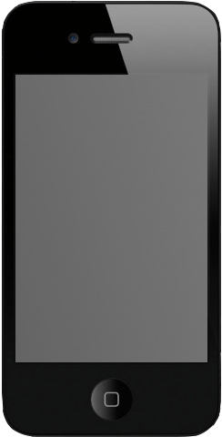
Main Layout of Android
Introduction
4.
Call to Hospital
5.
Sharing the state of Health with family
Idea
3.
Check
Body tempera-ture
6.
Mypage
(Management +
Informa-tion
Progress
Schedules
2.
Check
Heartbeat rate
1.
Login

Slide 7
Detail Design For Application
Introduction
Idea
Progress
ID _________
PW _________
Schedules
Login
Join
Searching ID/PW
Layout_Login

Slide 8
Detail Design For Application
Introduction
Idea
Monday October 1
PM 02 : 15
Monday October 1
PM 02 : 15
Progress
100BMP
36.5’C
Schedules
Normal
Normal
Image about
How to use
Image about
How to use
Checking

Slide 9
Detail Design For Application
Introduction
Idea
A list of Hospital
할 심박 100
머 체온 36.5
니
Progress
Dentistry 111-1111
Schedules
아 심박 100
빠 체온 36.5
안과 222-1111
감기병원 123-5
엄 심박 100
마 체온 36.5

Slide 10
Detail Design For Application
Introduction
Idea
Health
Information
Member
Information
Health
Information
Member
Information
Progress
심박 100 BPM
체온 36.5 ’C
(그래프 추가)
회원 이름, 나이 등 회원가입 시 등록한 정보
Schedules
병력 목록
- 당료
- 다래끼
- 목감기
…
로그아웃

Slide 11
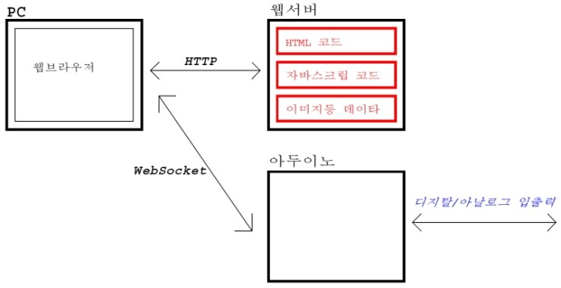
Detail Design For Application
Introduction
Implementation method
Idea
Progress
Schedules

Slide 12
Mini-spec
Introduction
process – mainpage (1.0)
Display consists of tilting function. when you touch one button, main page is moved to right side and when you touch it twice, move it to the detail page that matches the displayed page.
LOGOUT state
LOGIN state
Idea
Progress
로그인
심박측정
체온측정
Schedules
심박측정
체온측정
병원전화
걸기
가족건강
공유
MY PAGE

Slide 13
Mini-spec
Introduction
process – JOIN/LOGIN/LOGOUT (0.0)
JOIN | joining member in this application is required id, password and cell phone number and selectively enter your family code and own disease histories. The input information is stored in the member table of database. when you login our application.
LOGIN | if id and password of the database are checked, approval is granted.
LOGOUT | Logout is available from Member information page of mypage.
Idea
Progress
Schedules

Slide 14
Mini-spec
Introduction
 | process – measuring heart pressure(2.1) | process – measuring body temperature(2.2)
Initial screen | bringing the latest records together with date and output them on the screen
picture | How to measure a heart pressure using a one button | How to measure a body temperature using a one button
One button click | Save the measurement results to the database table and print them with the date on the screen.
Click twice | go to the main page(back)
Idea
Progress
Schedules

Slide 15
Mini-spec
Introduction
Idea
process – health information/member information(3.0)
Health information (initial screen) | Take the results of the last measurement and show them a graph. Shows the history of disease imported from the member table. In conjunction with the Family Information Sharing page, other families can view only limited information of my records.
Member information | The member information is imported and printed by the id and phone number of the member table. Modify button is to modify the member information.
Progress
Schedules
-11-

Slide 16
Mini-spec
Introduction
Idea
process – calling to hospital(4.0)
calling (Initial screen) | tilting list that print out the hospital name and telephone number that you entered when entering the member. when click a one button at list page, You have connected the dial so that you can dial the phone immediately.
Add phone number | The hospital information can also be added to the member's membership page when you join the member, but you can also add a ' + ' button on the page of the call page.
gps | show local hospital using GPS ,user’s input and google earth.
Progress
Schedules

Slide 17
Mini-spec
Introduction
Idea
process– sharing family information(5.0)
sharing (initial screen) | If sharing code is entered, bring member information of family that code is same at member table.
Family health information list | List the information from each family member gathered through the DB and list the output of each member. When we click one button, then move to that people’s health information page. (but output information is limited information.)
Progress
Schedules

Slide 18
Data flow
Introduction
Blood_
Pressure
Idea
DB
저장
Progress
Temperatrue
Schedules
원버튼
클릭
Main_
activity
장치 인식
Call
정보 출력
User
Information

Slide 19
Implemented Application
Introduction
Idea
Progress
Schedules

Slide 20
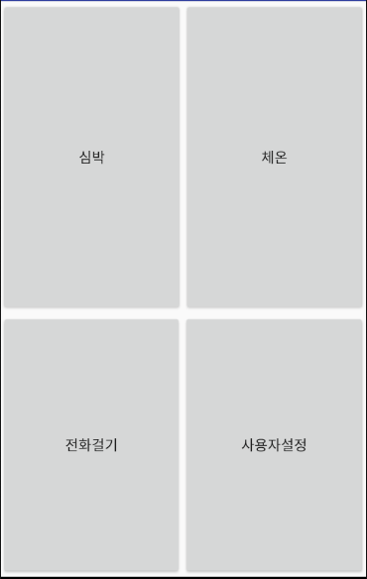
Implemented Application
Introduction
Idea
Progress
Schedules
Main

Slide 21
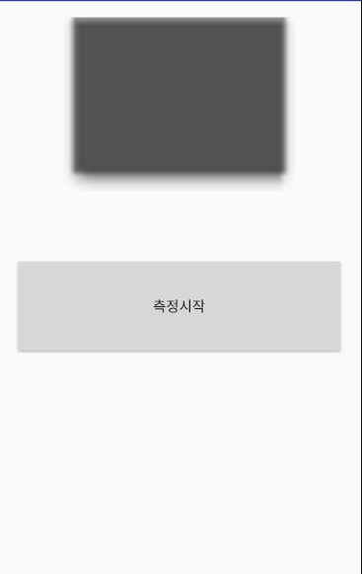
Implemented Application
Introduction
Idea
Progress
Schedules
Checking

Slide 22
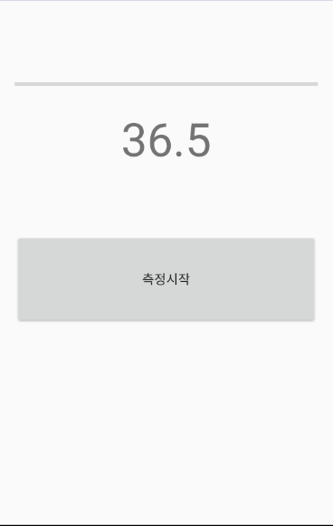
Implemented Application
Introduction
Idea
Progress
Schedules
Checking

Slide 23
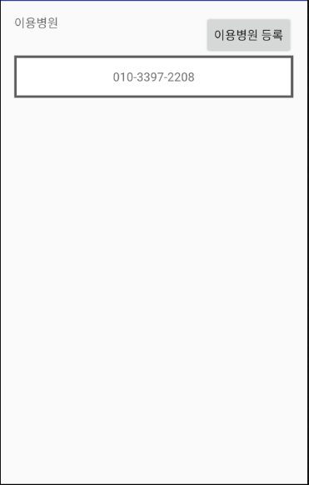

Implemented Application
Introduction
Idea
Progress
Schedules
Calling

Slide 24
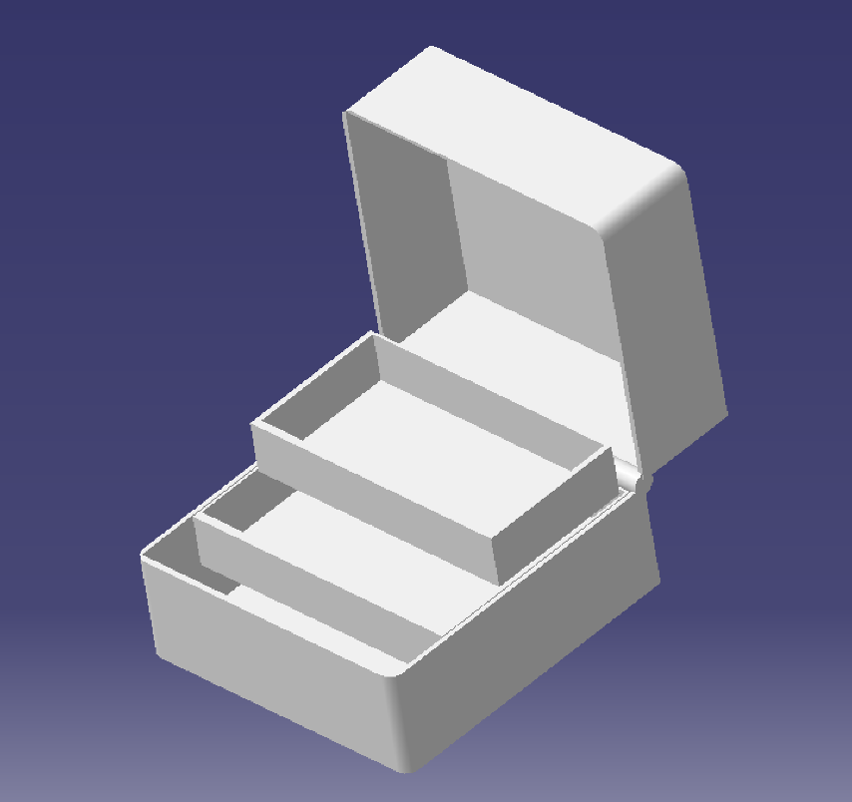
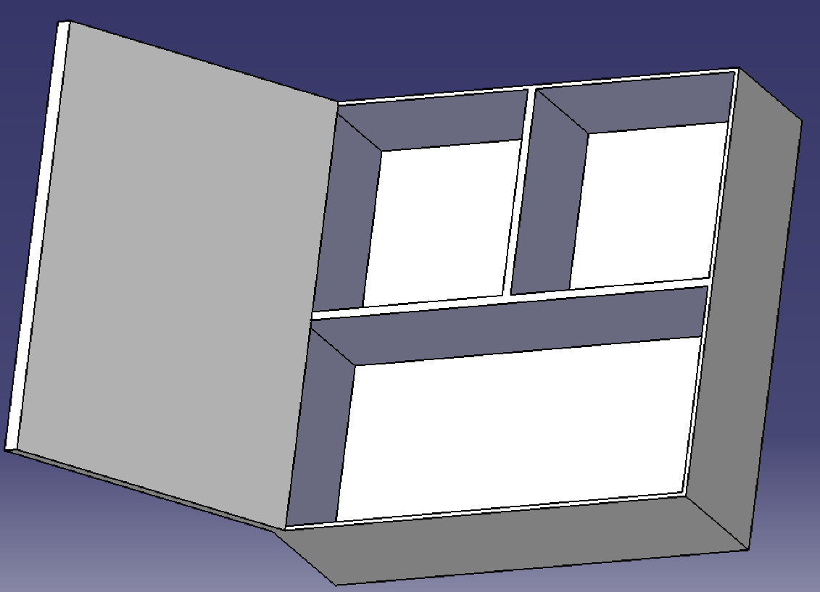
3D Design
Introduction
Example 1
Idea
Progress
Schedules

Slide 25
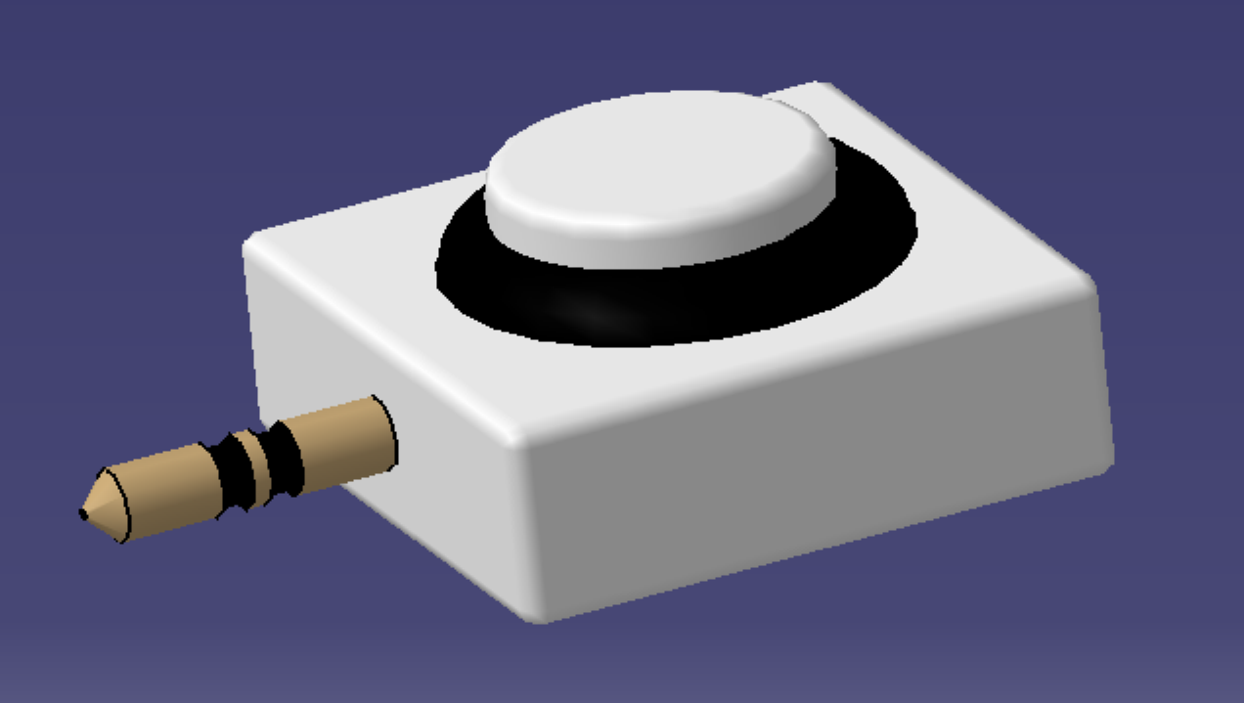
3D Design
Introduction
Idea
Example 2
Progress
Schedules

Slide 26
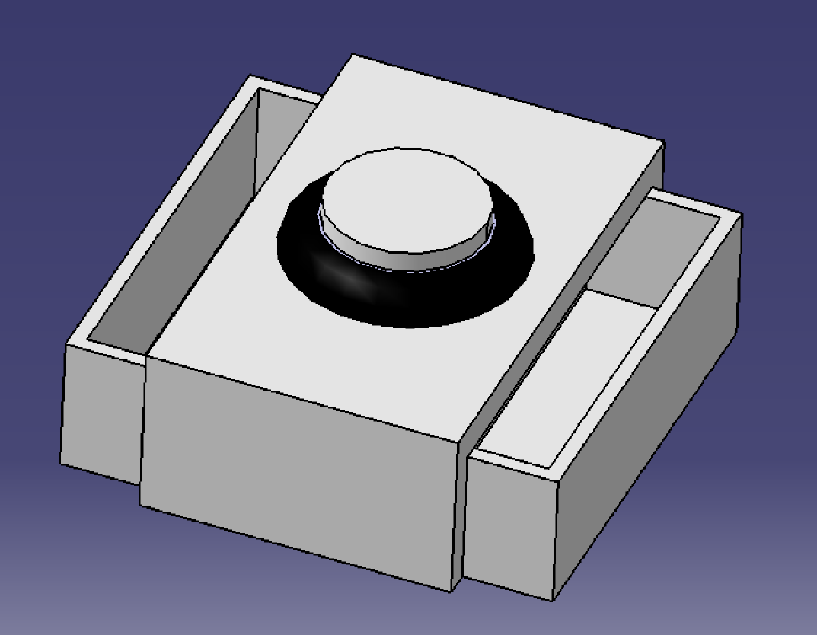
3D Design
Introduction
Example 3
Idea
Progress
Schedules

Slide 27
Arduino
Introduction
Idea
Progress
Schedules

Slide 28
Schedule
Category | September |  |  | October
 | 3 week | 4 week | 5 week | 1 week | 2 week | 3 week | 4 week
Plan
Requirements
Design
Implementation
Introduction
Idea
Progress
\
Schedules

Slide 29
Schedule
Category | November |  |  |  |  | December
 | 1 week | 2 week | 3 week | 4 week | 5 week | 1 week | 2 week
Implementation
Testing
Evolution
Introduction
Idea
Progress
\
Schedules

Slide 30

Q & A
2016 소프트웨어공학
Team 1

Slide 31
Thank you.
2016 소프트웨어공학
Team 1

